Slide 1
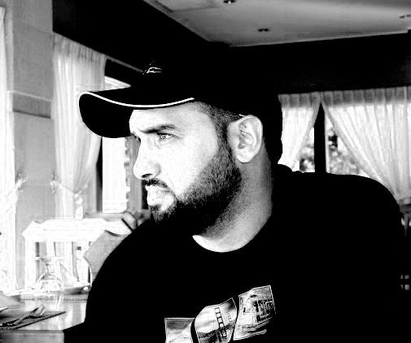

JavaScript Basic
Abdulkarim Albanna
www.abedelkarim.com
www.facebook.com/abdulkarimAlbanna

Slide 2
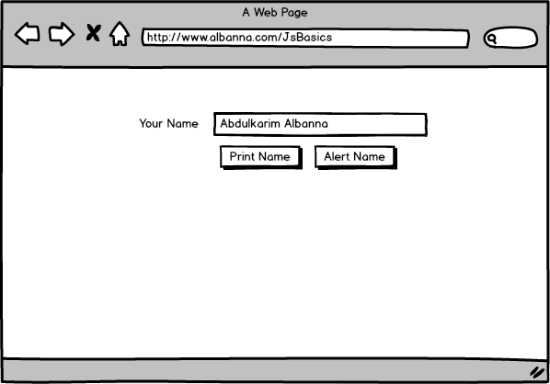
JavaScript Basic Example 1

Slide 3
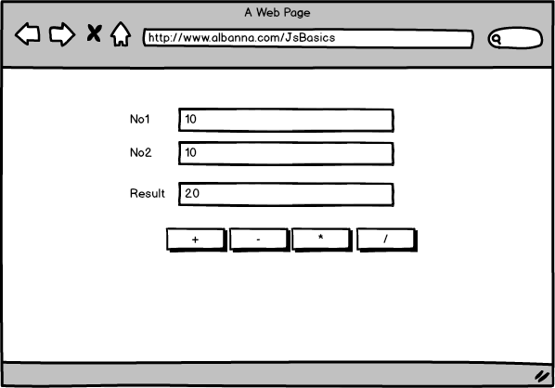
JavaScript Basic Example 2

